Slide 1
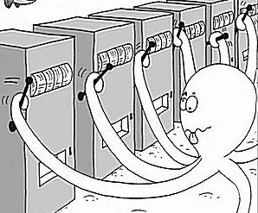
Multi-Armed Bandit
Sanjay Hariharan, Sunith Suresh, Lin Xiao, Ilan Man

Slide 2
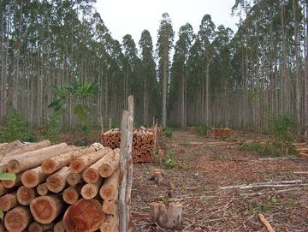

Exploration vs. Exploitation
Exploitation: Capitalizing on information available so far
Exploration: Acquiring New Information
“Bandit problems embody in essential form a conflict evident in all human human action: information verses immediate payoff.”
Notes:
Applications!!
Regret vs. Reward (opportunity cost)

Slide 3

List of Algorithms
Dynamic Programming
Thompson Sampling
𝜺-Greedy
Upper Confidence Bounds (UCB)
AdBandit (pure exploitation)
Gaussian Processes
Many More!

Slide 4
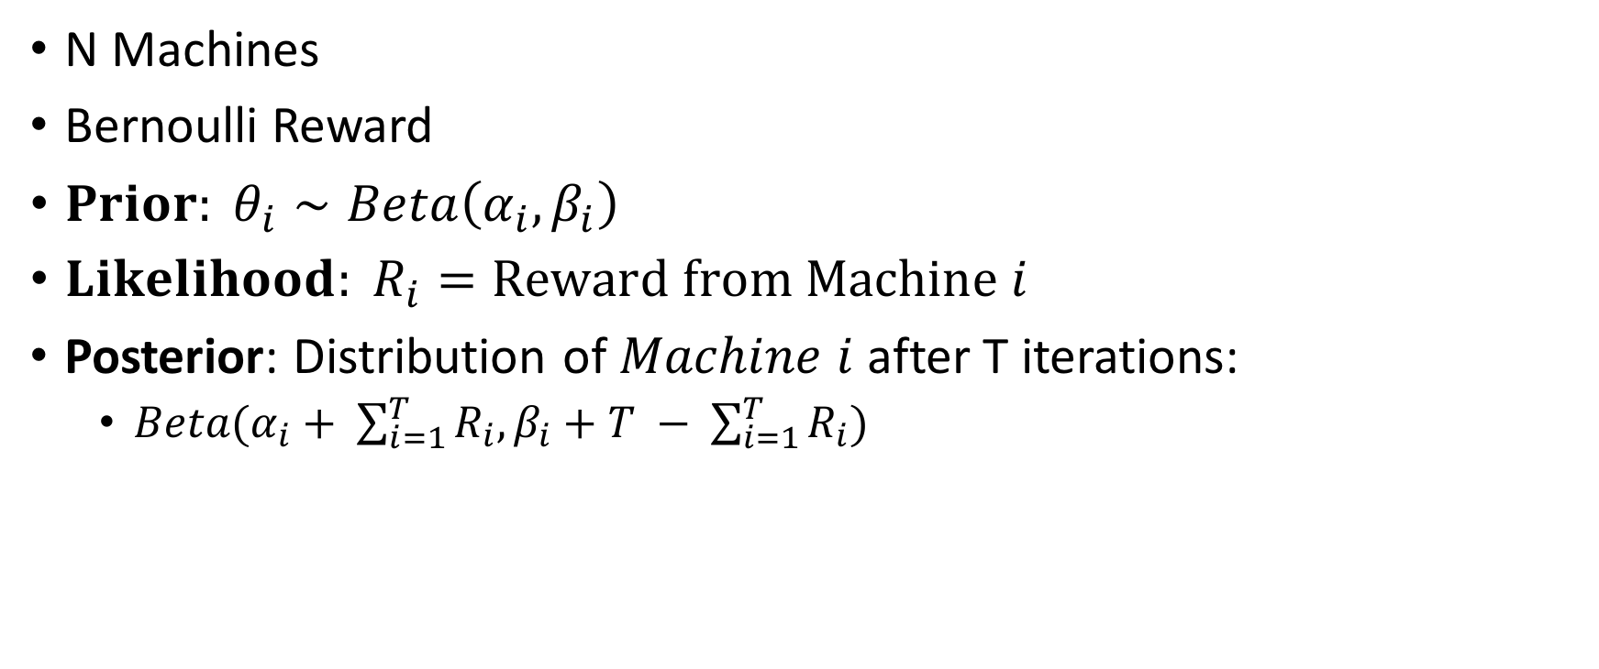
Bernoulli Bandit
😎
😭

Slide 5
Dynamic Programming
Backwards Algorithm

Slide 6
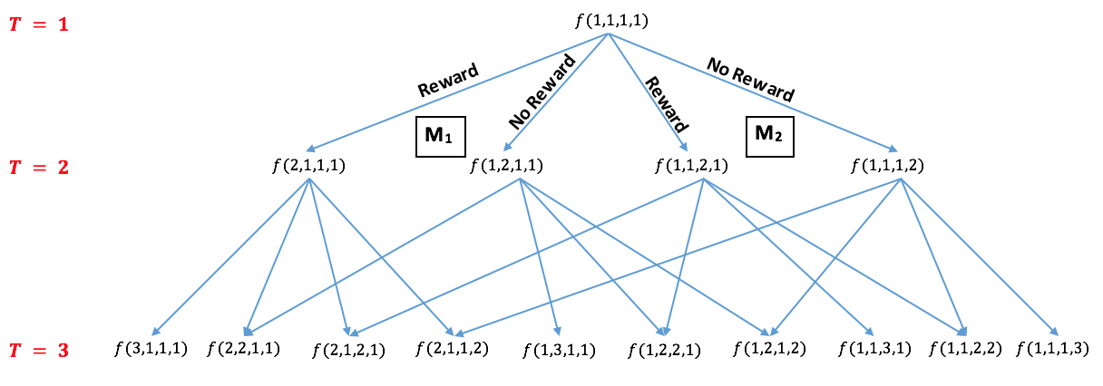
Dynamic Programming
Backwards Algorithm

Slide 7

𝜺-Greedy
Epsilon: Explore
1-Epsilon: Exploitation
Notes:
Now we discuss some alogrithms that are described in literature. The move naive algorithm is the epsilon greedy algorithim. So the problem with pure exploitation algorithim is that you could get stuck at a suboptimal machine. The epsilon greedy algorithim solves this problem by introducing some exploration. Epislon-greedy algorithm, for N iterations you explore machine epsilon percent of the time and for the 1-epsilon percent of the time you will greedily exploit the best machine. So the epsilon parameter essentially control the amount of exploitation and exploration that the algorithm does. One issue is the constt
Easy to implement
Easy to understand
And it works pretty well;

Slide 8

Thompson Sampling
EXPLORE!

Slide 9
Thompson Sampling
EXPLORE!
EXPLOIT!

Slide 10
Thompson Sampling
EXPLORE!
EXPLOIT!
THOMPSON!

Slide 11
Concentration bounds
sequence of n independent fair coin flips

Slide 12
Concentration bounds
sequence of n independent fair coin flips
let X be the number of heads

Slide 13
Concentration bounds
sequence of n independent fair coin flips
let X be the number of heads
probability of having no more than n/4 heads

Slide 14
Concentration bounds
sequence of n independent fair coin flips
let X be the number of heads
probability of having no more than n/4 heads
# flips to bound deviation from expected value

Slide 15
Concentration bounds
Chebyshev Inequality - use the variance of X
P(|X − E(X) | ≥ a ) <= Var(X)/a^2

Slide 16
Concentration bounds
Chebyshev Inequality - use the variance of X
P(|X − n/2 | ≥ n/4 )
<= Var(X)/ [(n/4)^2]
<= 4/n

Slide 17
Concentration bounds
Chernoff bounds - assume X’s are independent
P(|X − mu | ≥ a*mu)
<= 2e^(-mu*a^2/3)

Slide 18
Concentration bounds
Chernoff bounds - assume X’s are independent
P(|X − n/2 | ≥ n/4 )
<= 2e^(-n/24)

Slide 19
Concentration bounds
Chernoff bounds - assume X’s are independent
EXPONENTIALLY SMALLER PROBABILITY
P(|X − n/2 | ≥ n/4 )
<= 2e^(-n/24)

Slide 20

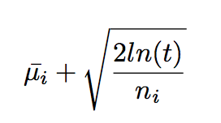
Upper Confidence Bound (UCB)

Slide 21
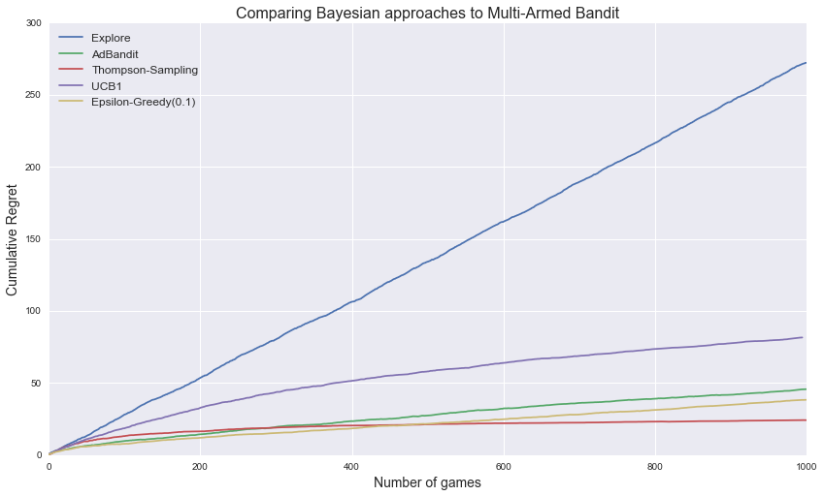

Slide 22
Gaussian Processes
Useful in continuous case!

Slide 23
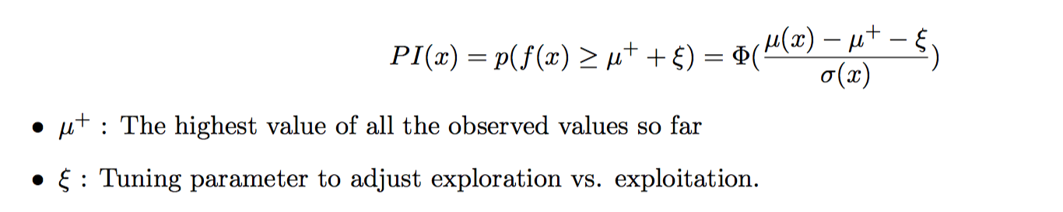
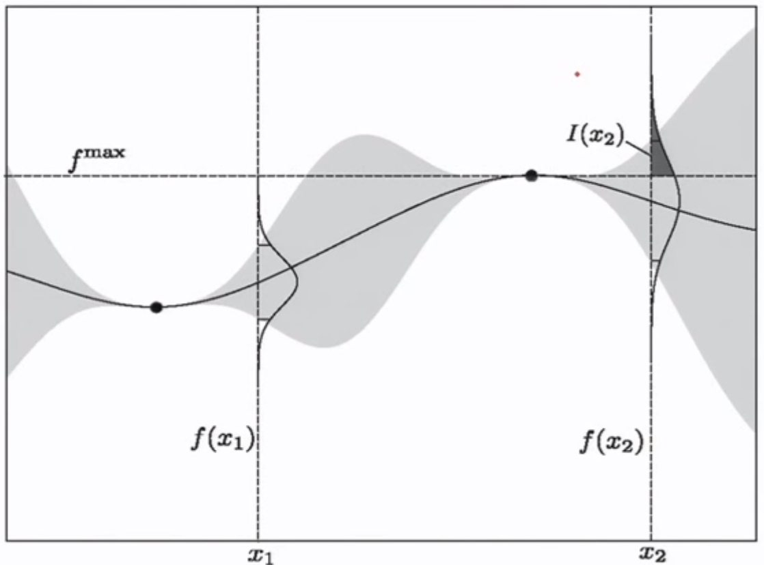
Probability of Improvement (PI)

Slide 24
GP Fit Over Time

